Slide 1
City Explorer
By
Amigos

Slide 2
Agenda
Carla simulator
Tools used
Driving Scenarios
Conclusion

Slide 3
Carla Simulator
Open source driving simulator
Supports training and testing of autonomous vehicles
Simulator suitable for urban driving conditions
Interfaces with ROS
Works with linux platform

Slide 4
Tools used
Carla simulator
Python/OpenCv
Ros/Rviz
Matlab

Slide 5
Driving scenarios
Lane keeping
Stop for traffic light
Stop in case of getting close to other cars

Slide 6
Lane keeping
Input Image
Apply color and gradient threshold
Get Birds Eye view of the road
Get location of road using curve fitting
Calculate distance of car from left and right lane
PID Controller
Steering Input

Slide 7
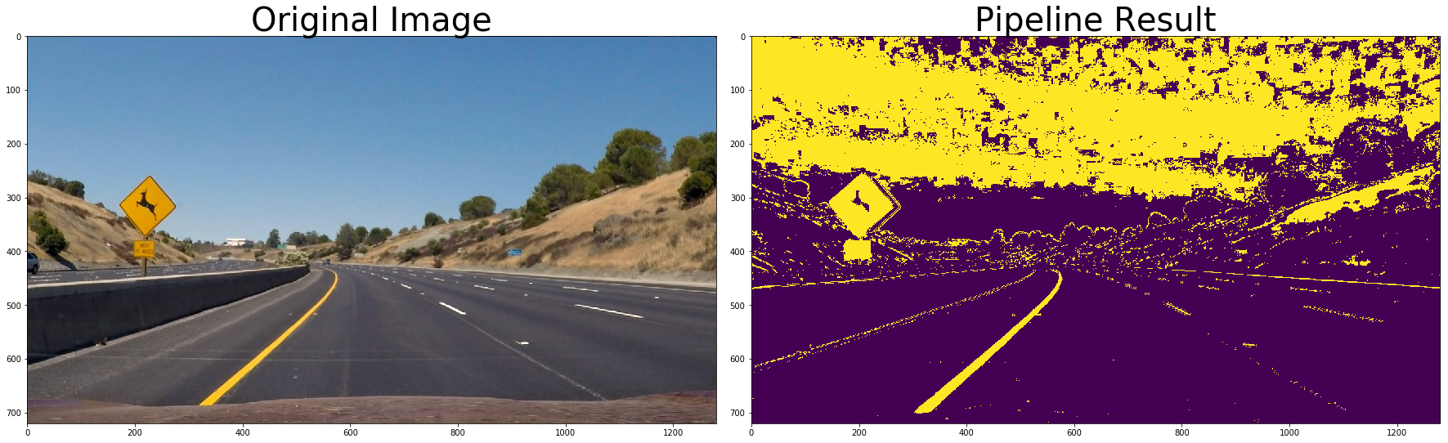
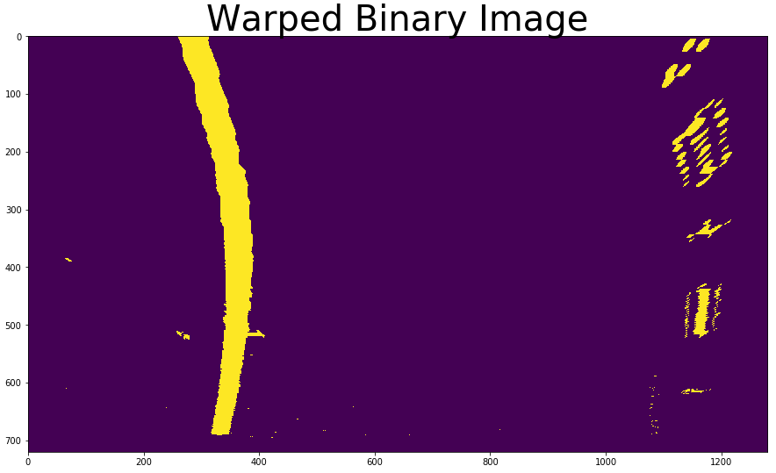
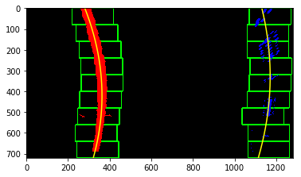
Example

Slide 8
Stop for Traffic light
The Carla simulator provides semantic segmentation
Using segmented image the traffic sign is extracted
The red traffic light is detected using color filtering
The car is stopped once the red light is detected

Slide 9
Stopping for other cars
Other cars are detected using segmented image
The cars in the front of our car are detected
Our car is slowed down or stopped when vehicles come closer

Slide 10
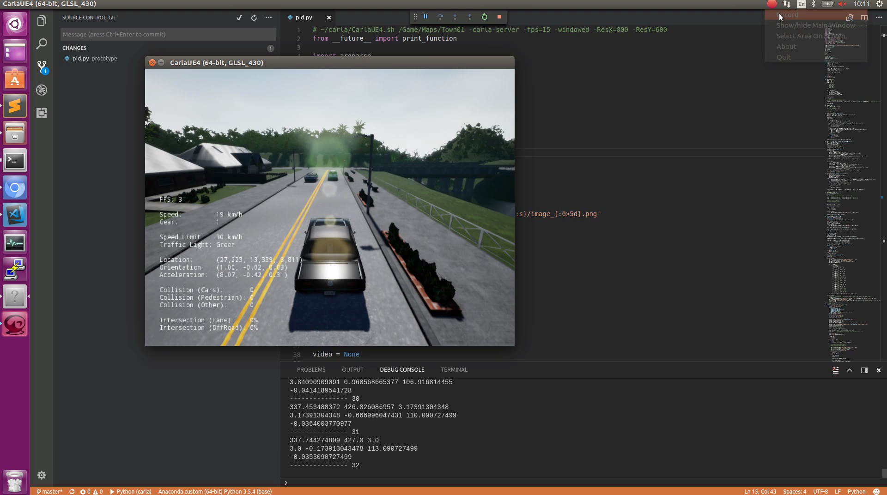
Output Video

